Slide 1
Building Reliable Applications
Waseem Kntar, Tech Lead
Syria Tech Meetup
26 Sep 2026

Slide 2
Content
1
What & Why Reliability ?
2
Get, Create Leads
3
Sending WhatsApp Messages
4
Webhooks Handling
5
Safe Deployment
2/30
26 Sep 2026

Slide 3

What is Reliability?
Building Reliable Applications
The System should continue to work correctly (performing the correct function under the desired level of performance),
Even in the face of adversity (hardware faults, software bugs or even human errors).
Source: Designing Data-intensive Applications Book p. 6
3/30
26 Sep 2026

Slide 4
Why Reliability?
Building Reliable Applications
Secret Management App Data loss:
Users will not be nice if their data are lost ! and could cost you a high penalty.
Payment Service Bug:
Users can lost money ! or charged many times, a real harm for them can cost your company a lot or could even close it entirely.
4/30
26 Sep 2026

Slide 5
Case Study #1:
Get, Create Leads
Building Reliable Applications
5/30
26 Sep 2026

Slide 6
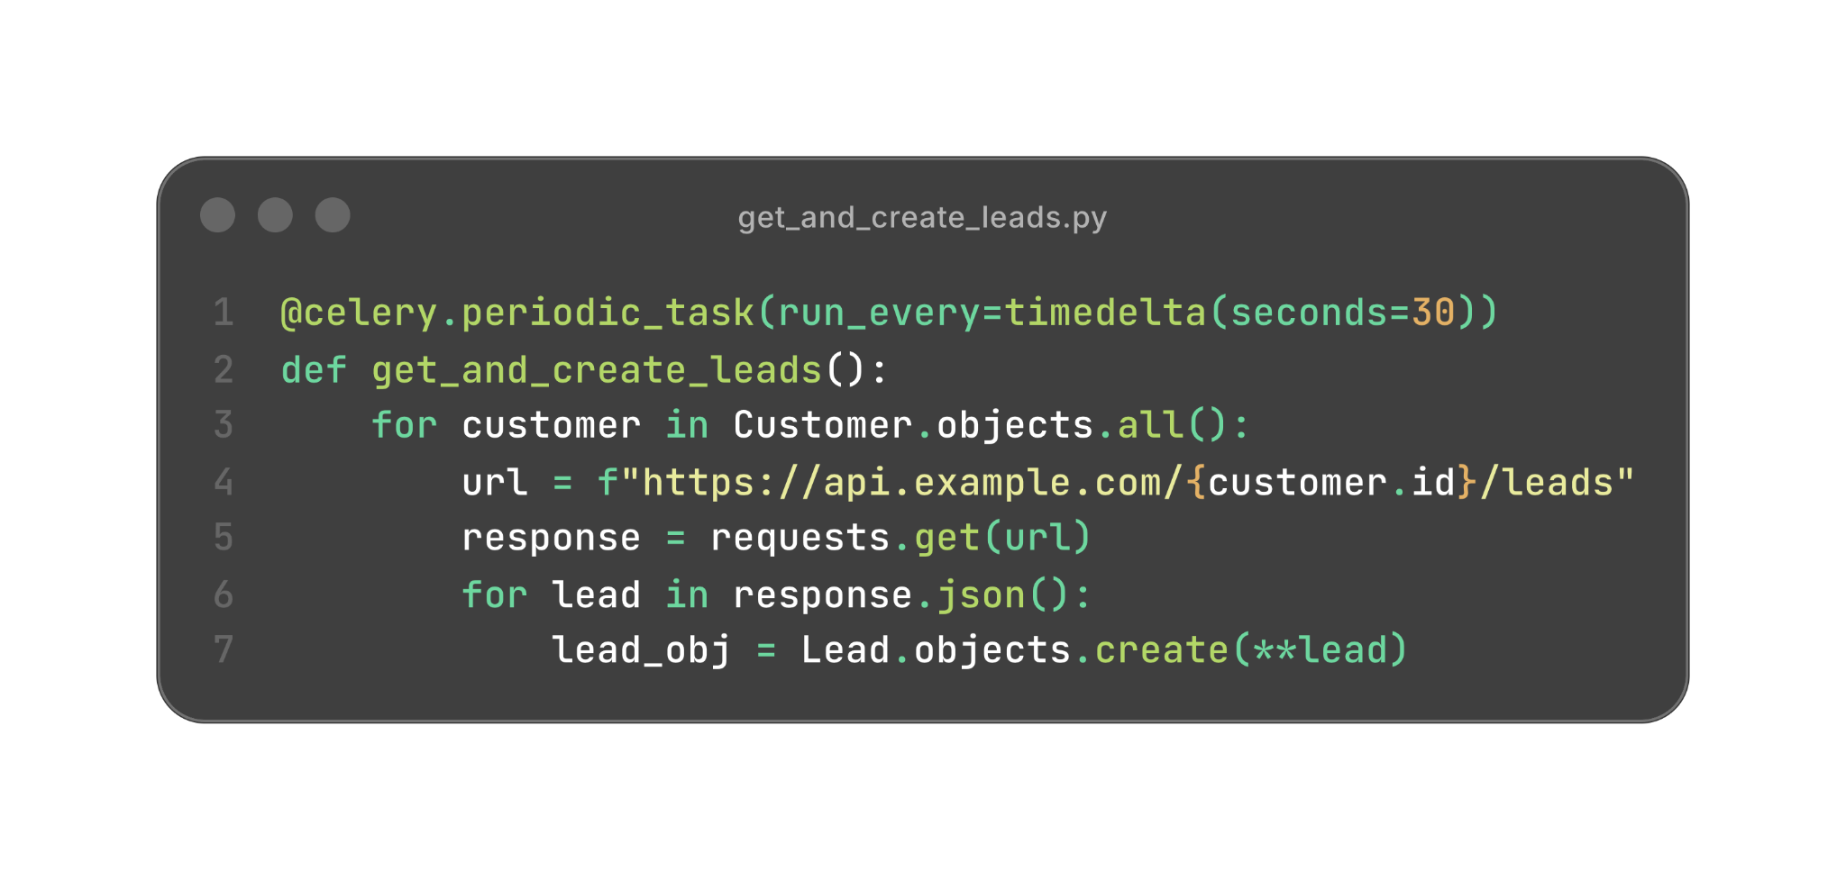
Get, Create Leads
Building Reliable Applications
What problems this code could have?
6/30
26 Sep 2026

Slide 7
Get, Create Leads
Building Reliable Applications
Problem #1:
if some exception happened during the process,
others leads from other customers may be blocked.
Example:
Not valid lead data, request timeout, response parsing error
7/30
26 Sep 2026

Slide 8
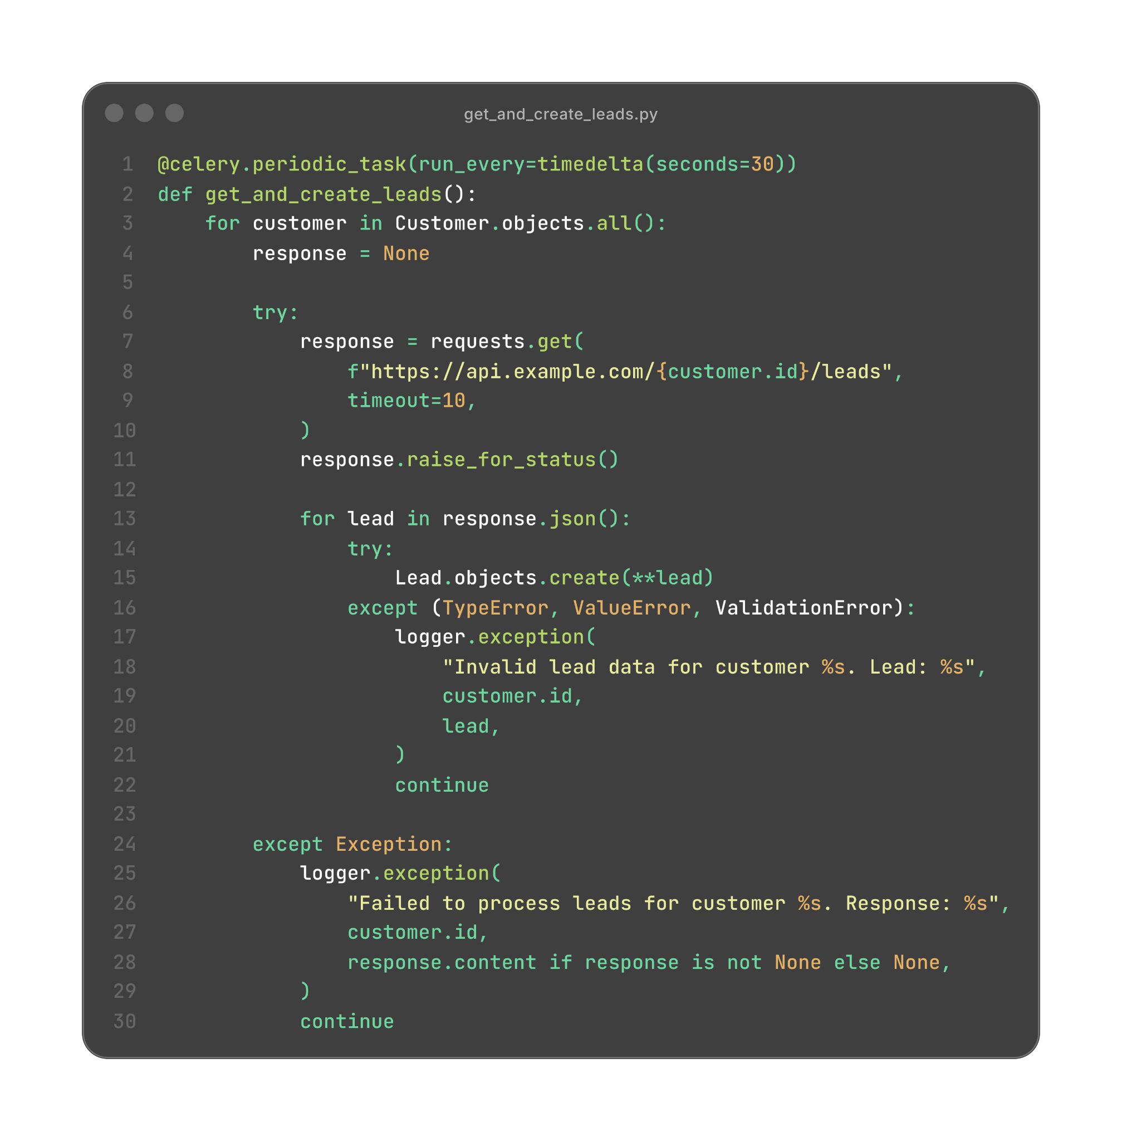
Get, Create Leads
Building Reliable Applications
Solution #1:
Error handling is required here,
Log the error, set an alert
and continue with the other customers’ leads
8/30
26 Sep 2026

Slide 9
Get, Create Leads
Building Reliable Applications
Problem #2:
This task can create a lead twice!
- Another worker pick the next get_and_create_leads when this one is not finished yet
- Or when the task is retried for some reason
9/30
26 Sep 2026

Slide 10
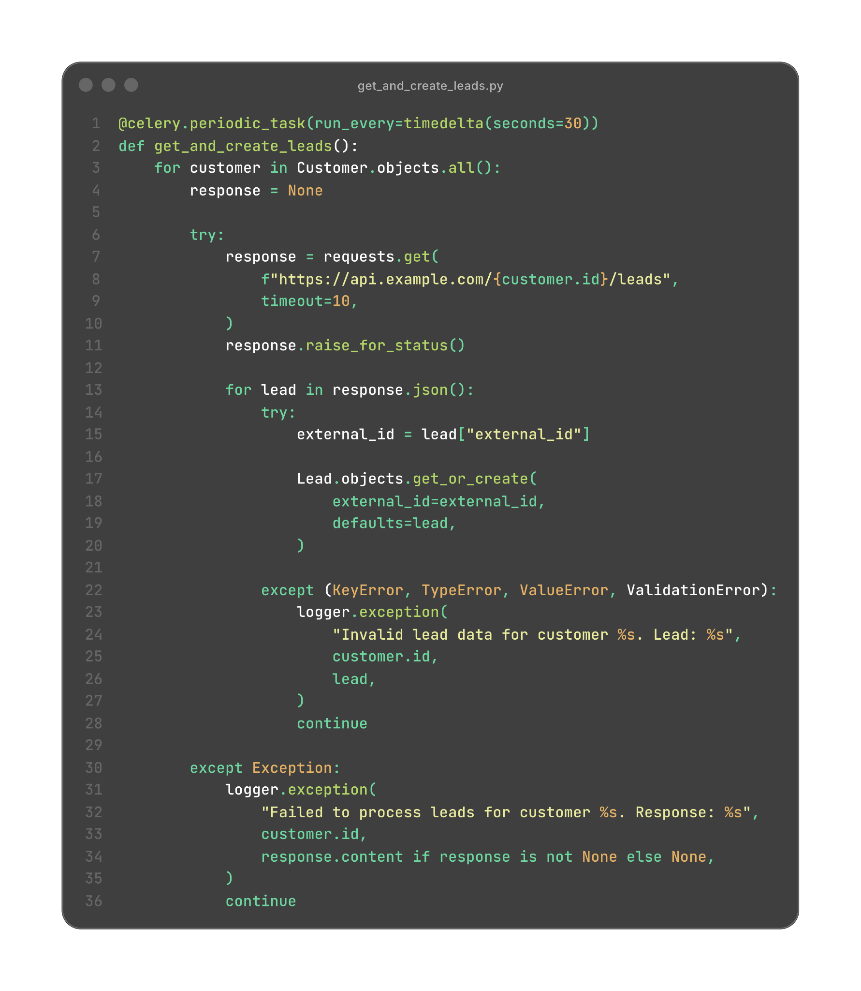
Get, Create Leads
Building Reliable Applications
Solution #2:
Use get_or_create instead of create, but with a UNIQUE db constraint
10/30
26 Sep 2026

Slide 11
Get, Create Leads
Building Reliable Applications
Problem #3:
Task can take long time, and exceeds worker time limit!
- It will be killed before getting all leads.
- This task can block other fast track tasks because of its long running time!
11/30
26 Sep 2026

Slide 12
Get, Create Leads
Building Reliable Applications
Solution #3:
Optimization:
Do it in batches, each batch could have 10 customers for example.
Create leads in bulk instead of one by one, this could produce a significant improvement (add ignore_conflicts).
Create a special queue for long running tasks to avoid blocking the fast track tasks.
12/30
26 Sep 2026

Slide 13
Get, Create Leads
Building Reliable Applications
Problem #4:
Scheduler publishes this task every 30 seconds, even when the previous execution is still running.
Another worker can therefore execute the same synchronization concurrently and attempt to create the same leads.
13/30
26 Sep 2026

Slide 14
Get, Create Leads
Building Reliable Applications
Solution #4:
Distributed lock:
Use a distributed lock with one stable key, such as:
locks:sync_all_leads
Acquire it atomically with SET NX EX, use a unique ownership token,
and release it only if the token still belongs to this worker.
The expiration prevents a crashed worker from leaving a stale lock.
However, the lock is not the primary protection against duplicates.
Lead creation must still be idempotent and protected by a database
unique constraint because locks can expire or fail.
14/30
26 Sep 2026

Slide 15

Less of Reliability is a less of imagination
Building Reliable Applications
15/30
26 Sep 2026

Slide 16
Case Study #2:
Sending WhatsApp Messages
Building Reliable Applications
16/30
26 Sep 2026

Slide 17
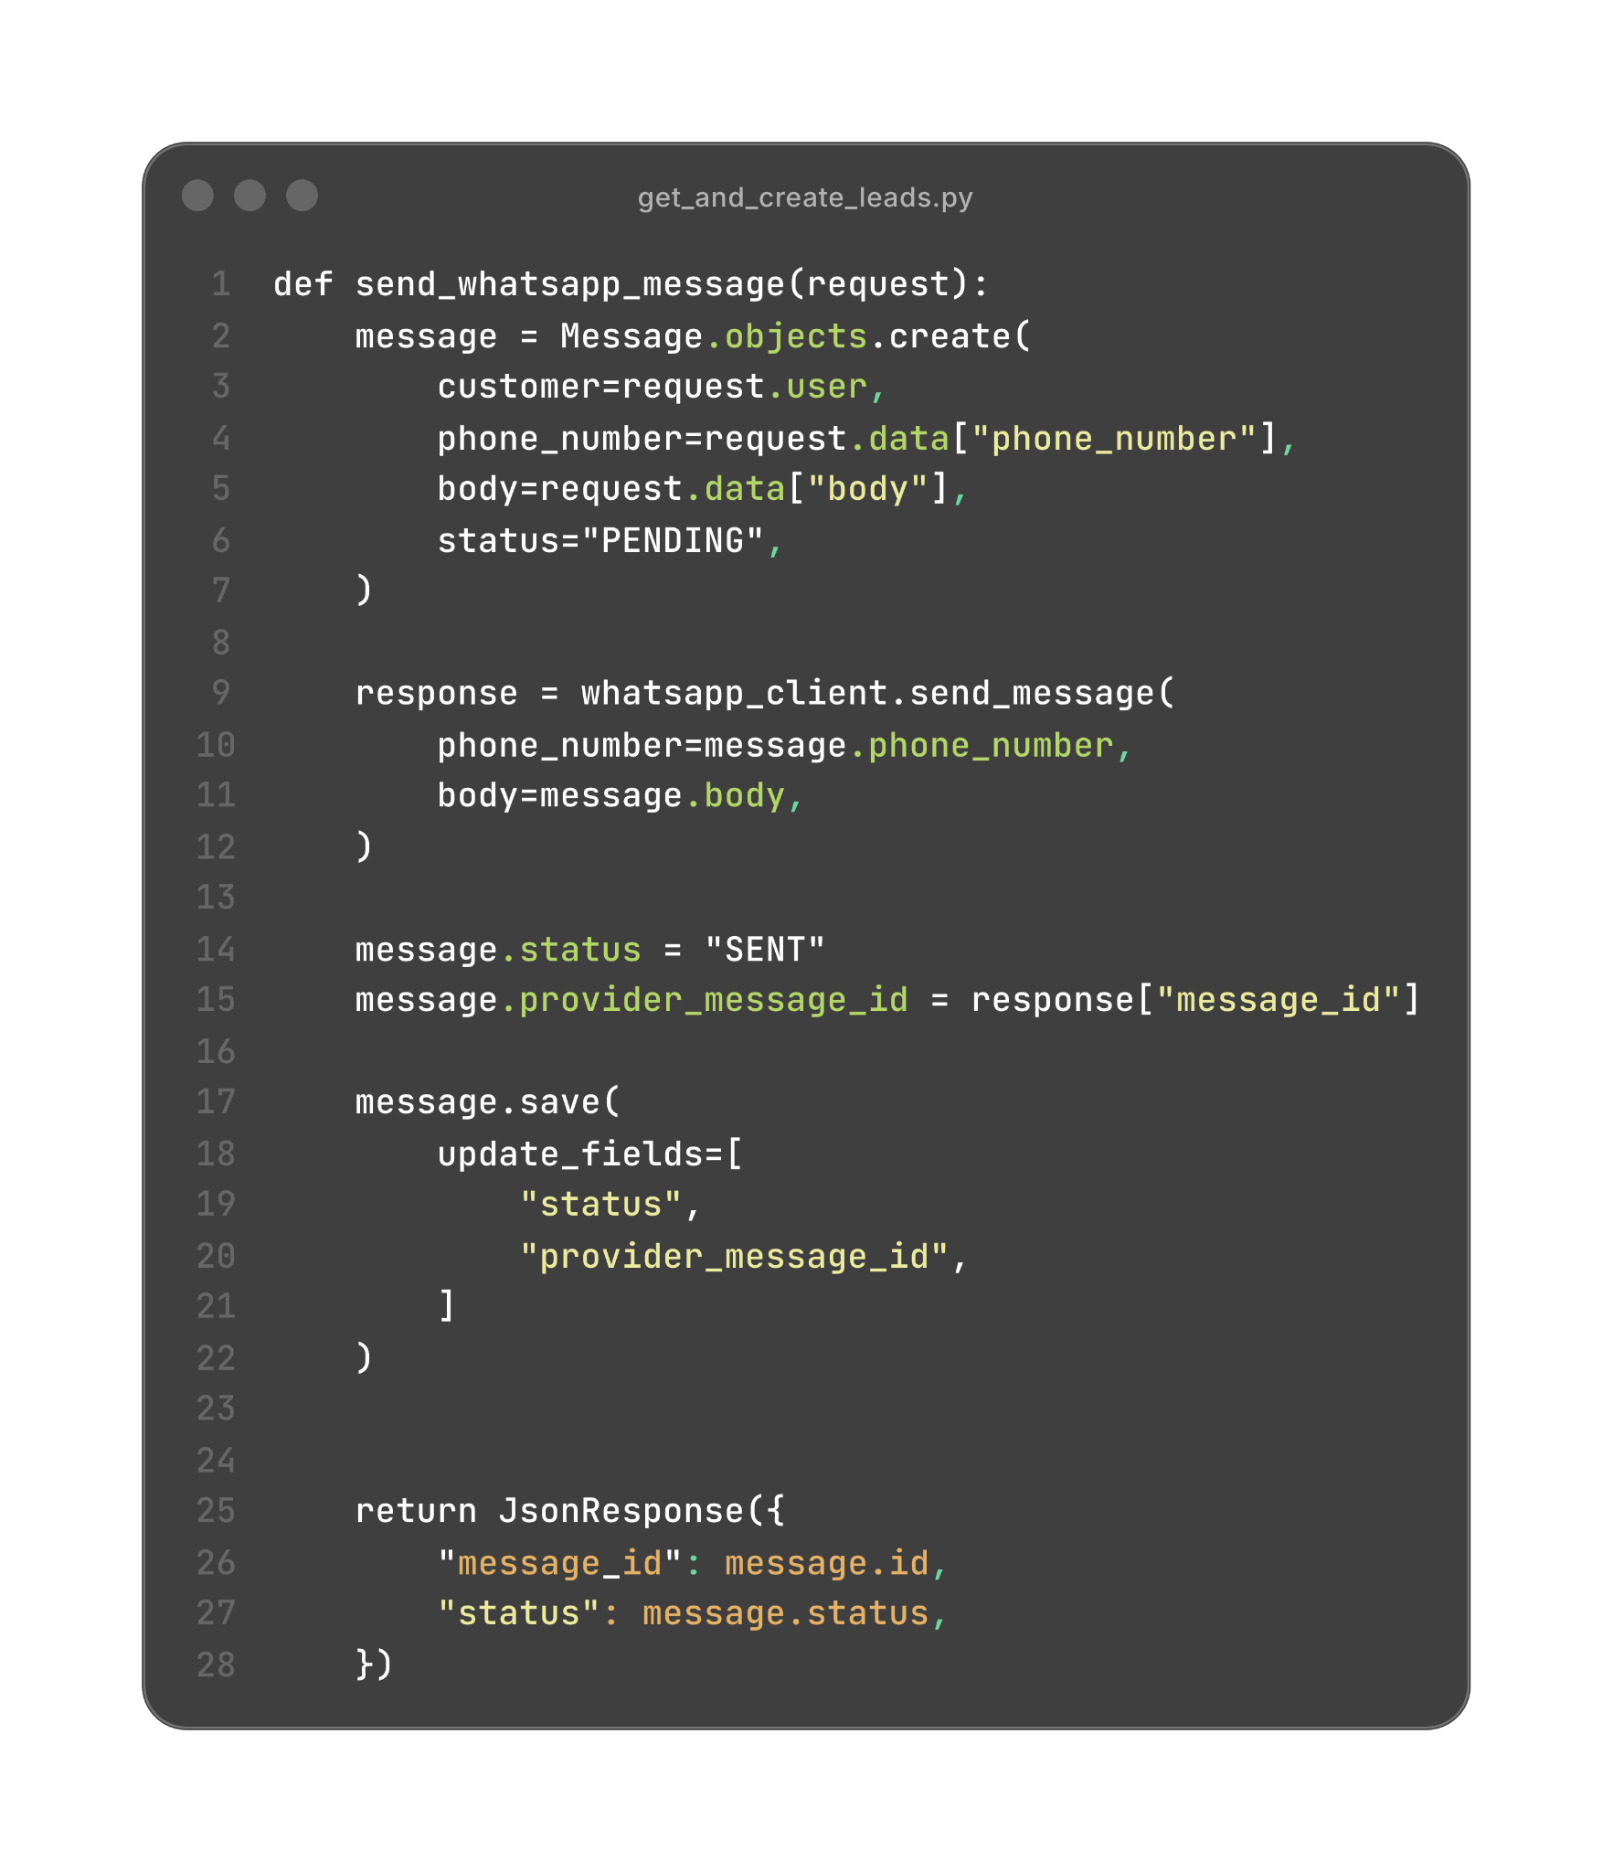
Sending WhatsApp Messages
Building Reliable Applications
What problems this code could have?
17/30
26 Sep 2026

Slide 18
Sending WhatsApp Messages
Building Reliable Applications
Problem #1:
Sending to WhatsApp fails:
If the message is created in the db but the sending to WhatsApp fails,
the message will be stuck in PENDING status and will never be sent.
18/30
26 Sep 2026

Slide 19
Sending WhatsApp Messages
Building Reliable Applications
Solution #1:
Retry:
we can use a retry mechanism to retry sending the message if it fails,
and set that in the status of the message to FAILED if it fails after a certain number of retries,
and we can have a separate task to retry sending the failed messages.
19/30
26 Sep 2026

Slide 20
Sending WhatsApp Messages
Building Reliable Applications
Problem #2:
Sending to WA can cost time!
This can slow down the system.
20/30
26 Sep 2026

Slide 21
Sending WhatsApp Messages
Building Reliable Applications
Solution #2:
Make it a background job:
we can use a separate task to send the message to WhatsApp in background.
4/20
26 Sep 2026

Slide 22
Sending WhatsApp Messages
Building Reliable Applications
Problem #3:
Sending task may crash or fail during the execution
4/20
26 Sep 2026

Slide 23
Sending WhatsApp Messages
Building Reliable Applications
Solution #3:
Retry or Sleep ?
It may help, but it will cause more processing and blocking time for the workers.
And what if the fail keeps happening, how to check the failed sends?
Digging into the logs ?!
4/20
26 Sep 2026

Slide 24
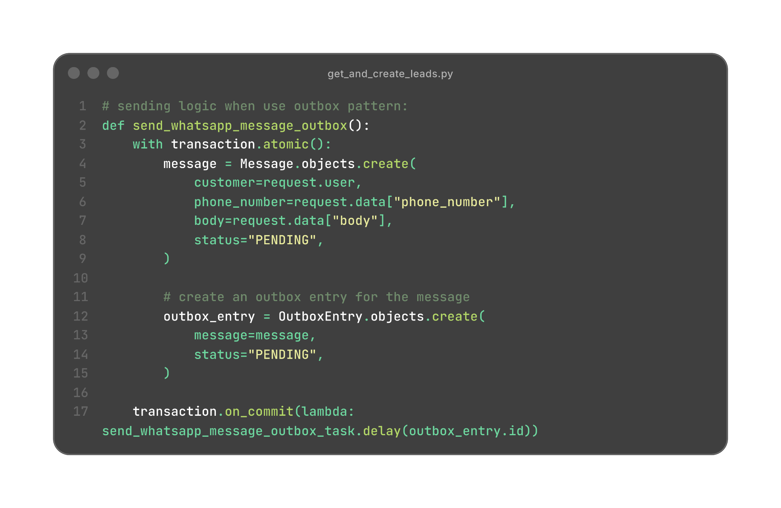
Sending WhatsApp Messages
Building Reliable Applications
Solution #3:
Outbox Pattern!
The simplest definition of the outbox pattern:
The transactional outbox prevents an external action from being forgotten after a database transaction commits.
It atomically saves the business change and a durable record of the external work that must happen later.
4/20
26 Sep 2026

Slide 25
Sending WhatsApp Messages
Building Reliable Applications
Solution #3:
Outbox Pattern!
There will be a special task to poll outbox entries and send message for each.
4/20
26 Sep 2026

Slide 26
Reliability is an additional cost (Complexity, Development time, Performance)
Building Reliable Applications
4/20
26 Sep 2026

Slide 27
Case Study #3:
Webhook Handling
Building Reliable Applications
4/20
26 Sep 2026

Slide 28
Case Study #4:
Safe deployment
Building Reliable Applications
4/20
26 Sep 2026

Slide 29
Any question ?
Building Reliable Applications
4/20
26 Sep 2026

Slide 30
Thank you
Contact?
Let’s talk
Waseem Kntar
waseem.kntar@gmail.com
https://linkedin.com/in/waseem-kntar
26 Sep 2026

